Slide 1
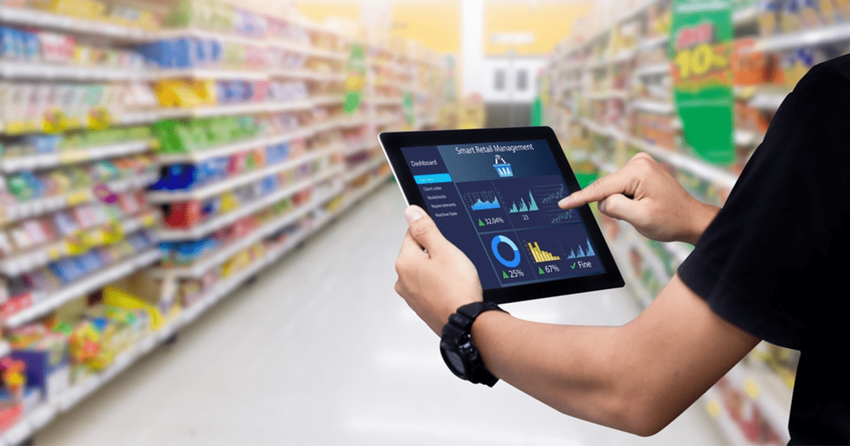
CALL CENTRE DASHBOARD
FINAL ASSIGNMENT, Group 11
BDAT 1009 – ENTERPRISE ANALYTICS

Slide 2
Team profile
Name | StudentID
Harsh Jajal | 200517816
Shaun George Dcunha | 200558437
Fareed Shahid | 200551973
Faraz Ahmed | 200547626

Slide 3

Dataset description
Id: Unique identifier for each record.
Call Timestamp: Timestamp indicating when the call was made.
Call-Centres City: City associated with the call center.
Channel: The communication channel used for the call (e.g., phone, chat, email).
City: City associated with the customer.
Customer Name: Name of the customer.
Reason: The reason for the customer's call.
Response Time: Time taken to respond to the call.
Sentiment: The sentiment associated with the call (e.g., positive, negative, neutral).
State: State associated with the customer.
Call Duration In Minutes: Duration of the call-in minutes.
Csat Score: Customer Satisfaction (CSAT) score, indicating the level of customer satisfaction.
This dataset appears to capture various aspects of customer interactions in a call center, including details about the calls, customer information, reasons for calls, response times, and customer satisfaction.

Slide 4
Strategy development
In leveraging insights from the call center dataset, a focused strategy is designed to enhance customer satisfaction and operational efficiency. A key aspect is understanding customer needs through a detailed analysis of call reasons. Efforts are directed towards optimizing response times, identified through the "Response Time" metric, and tailoring services to regional demands based on geographic analysis. Sentiment analysis guides improvements in customer interactions, while a proactive approach to maintaining high CSAT scores is adopted. Regular reviews ensure adaptability to evolving customer expectations. Implementation involves staff training, technology investments, and feedback loops for continuous improvement. This strategy aims to not only optimize operations but also elevate the overall customer experience for increased loyalty and positive brand perception.

Slide 5
SMART OBJECTIVE and KPI’s
The SMART objectives are as follows:
Objective: Increase Total Calls by 15% SMART Criteria: Specific: Achieve a 15% increase in the total number of customer calls.
KPI: Calculate Total Calls
Objective: Decrease Average Call Duration by 10%. SMART Criteria: Specific: Reduce the average time customers spend on calls by 10%.
KPI: Calculate Average Call Duration
Objective: Improve Response Time Percentage to 90% SMART Criteria: Specific: Increase the percentage of calls responded to within the target time to 90%.
KPI: Calculate Response time in Percentage
Objective: Decrease Total Call Duration (Minutes) by 8% SMART Criteria: Specific: Reduce the total duration of customer calls by 8%.
KPI: Calculate Total Call Duration(Minutes) and Top reasons for Calls
Objective: Convert 5% of Total Call Duration to Total Call Duration (Hours) SMART Criteria: Specific: Convert 5% of the total call duration from minutes to hours.
KPI: Calculate Total Call Duration in Hours

Slide 6
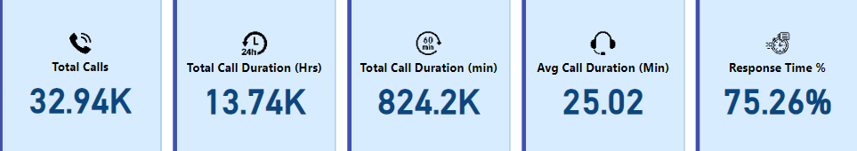
Analyze and visualize
For each of the objectives listed before, a KPI has been created to measure and track the performance of the goal.
Calculate Total Calls

Slide 7
The KPI cards was chosen streamlined and visually appealing way to present key performance indicators, promoting better understanding, engagement, and informed decision-making across various levels of an organization.
Total Calls: It is used to track and display the total number of calls received by the call centre over a specific period.
Total Call Duration in Hours: It is crucial to understand the total amount of time the call centre staff spends on call in hours which helps in resource allocation and capacity planning.
Total Call Duration in Minutes: Similar to the total call duration in hours, this KPI provides the total but in minutes, offering a more granular view of call durations.
Average Call Duration in Minutes: To assess the efficiency of the agents, we need to calculate and display the average call duration in minutes. This metrics can help identify trends in call handling.
Response Time Percentage: Response time is a critical factor in customer satisfaction. This KPI displays the percentage of calls answered within a predefined time frame, that helps to gauge the ability that will help in providing prompt service.

Slide 8
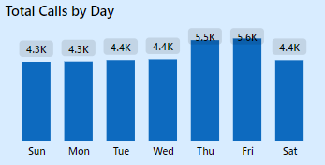
Total Calls by Days over a specific time period.

Slide 9
Total Calls by Days over a specific time period.
A Column chart is used to create this visual. Column charts offer a straightforward and effective means of visually representing data, making them a versatile and widely applicable tool for conveying information and supporting decision-making processes.
This Column chart provides a comprehensive view of the total number of calls received by the call center on a daily basis.
The horizontal axis represents each day, while the vertical axis indicates the corresponding total call count.
Each bar on the chart corresponds to a specific day, and the height of the bar reflects the total number of calls handled by the call center on that particular day.
Days with higher bars represent higher total call counts , and vice versa.
Using this Column chart, call center managers and stakeholders can gain valuable insights into daily call center operations, enabling more informed decision-making and continuous improvement in service delivery.

Slide 10
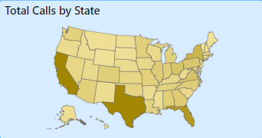
Total Calls by State.

Slide 11
Total Calls by State.
For this KPI we have used a Filled map chart. Filled map charts offer a powerful way to visualize and communicate geographical data, providing valuable insights into regional variations and trends. They are particularly effective when dealing with location-specific datasets or when geospatial context adds significant value to the analysis.
Filled map chart provides a compelling visual representation of the distribution of total calls handled by the call center across different states.
This dynamic chart utilizes color shading to convey the variations in call volumes, allowing for quick and insightful analysis of call center performance on a geographical scale.
The color gradient or spectrum used in the map corresponds to the range of call volumes.
Darker colors indicate higher call volumes, while lighter colors represent lower volumes.
The filled map chart assists in making informed decisions about resource allocation, staffing levels, and targeted strategies for states with distinct call center activity.

Slide 12
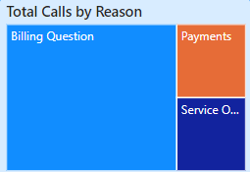
Top reasons for Calls.

Slide 13
Top reasons for Calls.
We have used Treemap visual in this KPI because they have the ability to present detailed information in a compact space makes them valuable for a wide range of applications.
This offers a visual overview of the most prevalent reasons for calls within the call center. This dynamic visualization breaks down and categorizes call data hierarchically, presenting a clear picture of the distribution of call reasons and their relative importance.
Larger rectangles represent call reasons with higher frequencies, indicating the top reasons for calls within the call center.
Different colors signify distinct call reasons, allowing for easy visual differentiation.
Use insights from the Treemap to inform strategic decision-making, such as resource allocation, training focus, or process improvement efforts.

Slide 14
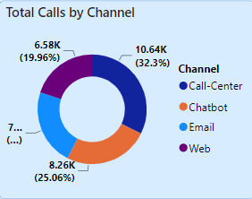
Total Calls by Channel.

Slide 15
Total Calls by Channel.
Donut chart was used for the KPI “Total Calls by Channel” because it has several advantages including their clear focus on data, visual appeal, and flexibility in displaying multiple series or datasets.
Donut Chart offers a comprehensive overview of call center activity by breaking down the total number of calls into distinct communication channels.
The Donut Chart is segmented into rings, each representing a specific communication channel. Channels include phone calls to Call Centre, emails, Chatbot and Web.
Each channel is color-coded for easy identification, creating a visually appealing chart. The use of distinct colors enhances the clarity of the representation.
The size of each ring is proportional to the total number of calls received through the corresponding channel. Larger rings indicate higher call volumes for that particular communication method.
Donut Chart is a powerful tool for visually communicating the distribution of call volumes across different communication channels in a call center. It aids in making informed decisions related to resource allocation, service improvement, and overall operational efficiency.

Slide 16
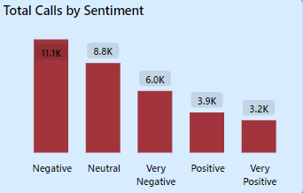
Total Calls by Sentiment.

Slide 17
Total Calls by Sentiment.
We used another Column chart for this KPI because it has simple, straightforward and effective way of representing data.
This Column chart helped with a comprehensive depiction of call center interactions categorized by sentiment.
The Column Chart is divided into distinct bars, each representing a specific sentiment category. sentiment categories include Very positive, positive, neutral, negative and Very negative providing a comprehensive view of customer feedback.
The height of each bar corresponds to the total number of calls associated with a particular sentiment. Taller bars indicate higher call volumes for that specific sentiment category.
Data labels on top of each bar display the exact count of calls for each sentiment category, providing precise information without the need for additional reference.
It provides a visual snapshot of sentiment distribution, supporting efforts to enhance customer satisfaction and improve overall service quality.

Slide 18
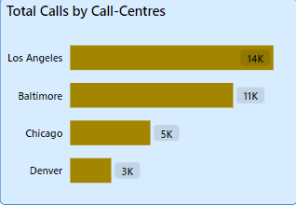
Top Call Centres with most calls.

Slide 19
Top Call Centres with most calls.
A Horizontal bar chart is to visualize this KPI because it a versatile and effective visualization tool that provides clear comparisons and is particularly useful when dealing with a large number of categories or long labels. Its ease of interpretation and space efficiency make it a valuable choice for conveying information in a visually accessible manner.
The chart adopts a horizontal layout, with each bar representing a specific call center. The length of each bar directly corresponds to the total number of calls handled by that center.
Bars are sorted in descending order based on call volume, placing the call center with the highest number of calls at the top. This arrangement facilitates easy identification of the top-performing call centers.
Data labels are placed at the end of each bar, displaying the exact count of calls handled by each call center.
The visualization supports data-driven decision-making by offering insights into call center efficiency and workload distribution.

Slide 20
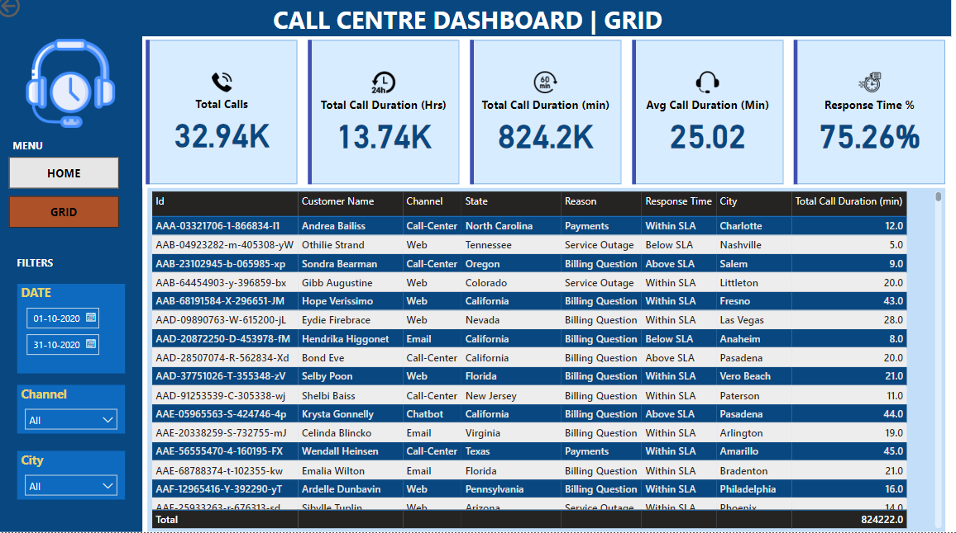
Grid View
We have created a Grid View Dashboard that present information in a structured grid format. This dashboard offers a tabular layout, providing users with a comprehensive and organized view of data across various dimensions.
The dashboard adopts a tabular structure, resembling a grid with rows and columns. This layout facilitates a systematic organization of information, making it easy for users to locate and analyze data.

Slide 21
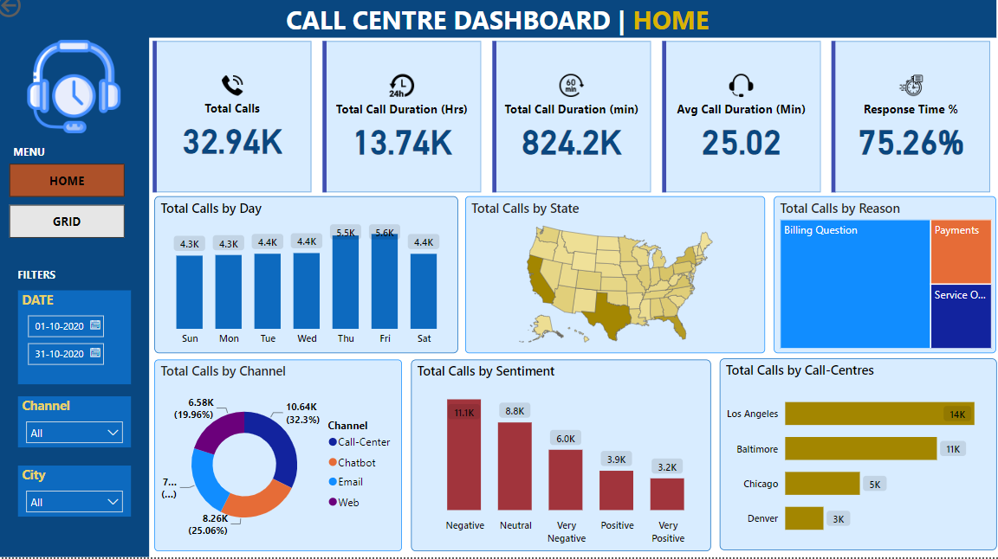
CALL CENTRE DASHBOARD
By Combining all the KPI’s created we have created a user- friendly and interactive dashboard.
In this dashboard, we have inserted a Menu button which helps to switch between Dashboard and Grid view.
We have included different filters like Date, Channel and City which will help the user to see more precise insights.
This will provide actionable insights, enhance operational efficiency, and ultimately improve the overall customer experience.

Slide 22
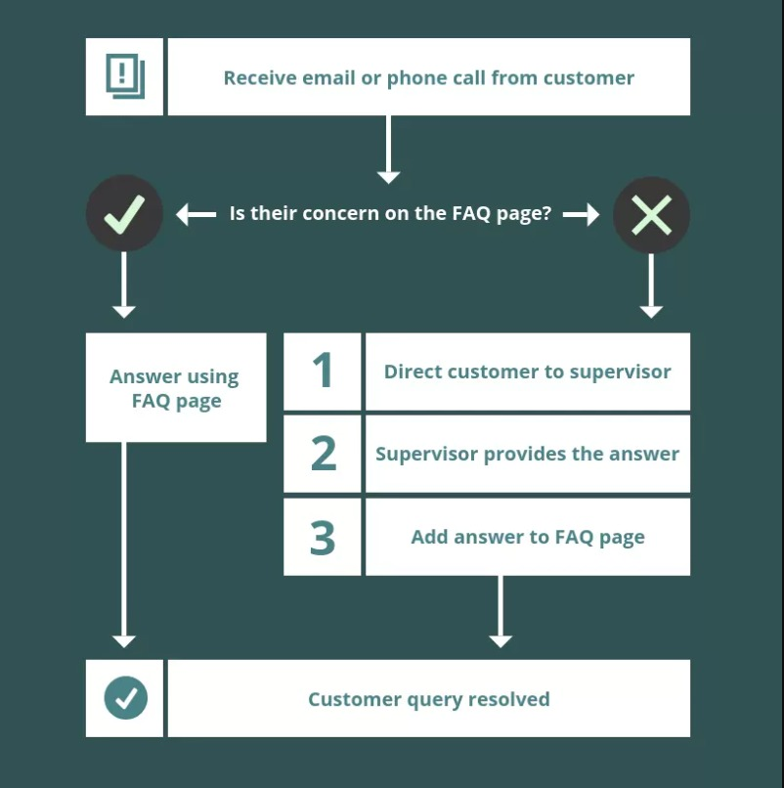
Data flow diagram
Data Source: The data flow begins with various data sources, which can include databases, spreadsheets, online services, or other repositories where the raw data is stored.
Data Extraction: Data extraction involves pulling the required data from diverse sources. This process may include extracting data from relational databases, flat files, APIs, or other data storage systems.
Data Transformation: Transformation activities may include cleaning data, filtering, aggregating, and structuring it for optimal analysis.
Data Modelling: Data modeling involves designing relationships between tables, creating calculated columns, measures, and hierarchies. This step is crucial for establishing how data elements relate to each other.
Data Loading: After transformation and modeling, the prepared data is loaded into the Power BI model. This step populates the Data Model within the Power BI file or service.
Data Visualization: The data visualization step involves presenting the prepared data in a visually appealing manner through charts, graphs, maps, and other visual elements.
Report and Dashboard creation: With the prepared data in Data Model and Visualization are used to create a comprehensive and user-friendly dashboard.

Slide 23
Recommendations
These recommendations aim to address each SMART objective by providing actionable steps to achieve the defined goals. Implementing these suggestions should contribute to the success of your call center strategy.
Recommendation for Increasing Total Calls by 15%: Implement targeted marketing campaigns to attract new customers. Offer promotions or incentives to encourage existing customers to engage in more calls.
Recommendation for Decreasing Average Call Duration by 10%: Conduct staff training on effective issue resolution and communication skills. Implement self-service options to address common customer queries.
Recommendation for Improving Response Time Percentage to 90%: Prioritize high-impact calls and allocate resources accordingly. Implement automated systems for quick issue identification and response.
Recommendation for Decreasing Total Call Duration (Minutes) by 8%: Streamline internal processes to reduce unnecessary delays. Provide agents with access to comprehensive customer information for quicker issue resolution.
Recommendation for Converting 5% of Total Call Duration to Total Call Duration (Hours): Enhance reporting systems to automatically convert call duration units to hours. Provide user-friendly dashboards that display call duration in both minutes and hours.

Slide 24
Thank you!

